Slide 1


Tóth Erik István – Database, Project manager
Bércesi Krisztián – Backend
Tóth Botond Béla - Frontend
KEB WEBSHOP
http://www.kebshop.hu

Slide 2
INTRODUCTION
FRONTEND
COMMUNICATION
JIRA WORKSPACE
DATABASE
CONTENTS
BACKEND
PAGE DEMO
QUESTIONS

Slide 3
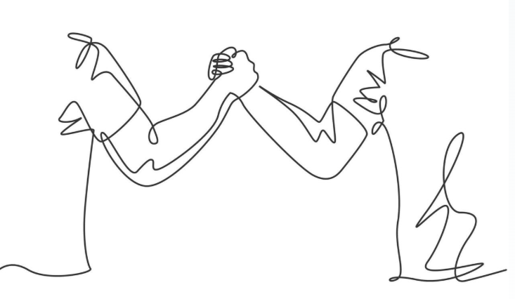
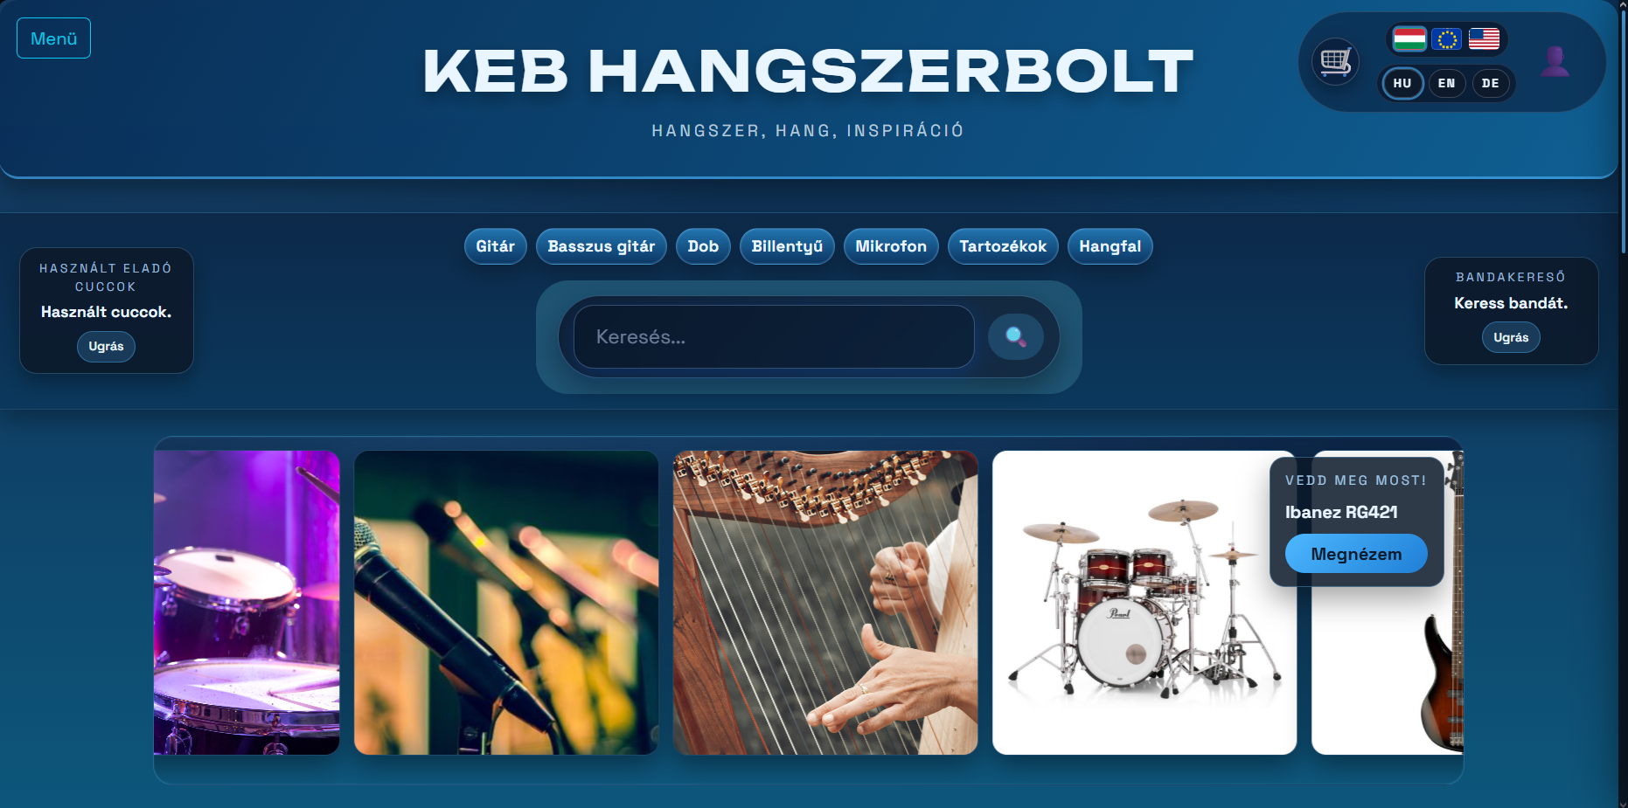
INTRODUCTION
„FROM MUSICIANS, TO MUSICIANS”
Our platform aims to support musicians.
An international social place fror musicians.
We aimed to create something entirely new.

Slide 4

FRONTEND – Tóth Botond
01
02
03
04
05
How i formed the page
Why did i choose this theme/How did i align it with Music?
My frontend Development.
JIRA workspace
Figma desing

Slide 5

FRONTEND – Tóth Botond
Why did i choose this theme?
Our team is full with musicians/music lovers
We know what’s lacking in online music stores.
We think that a best developer is a user.
We found the concept exciting and wanted to create our own, adding our personal ideas and improvements.

Slide 6
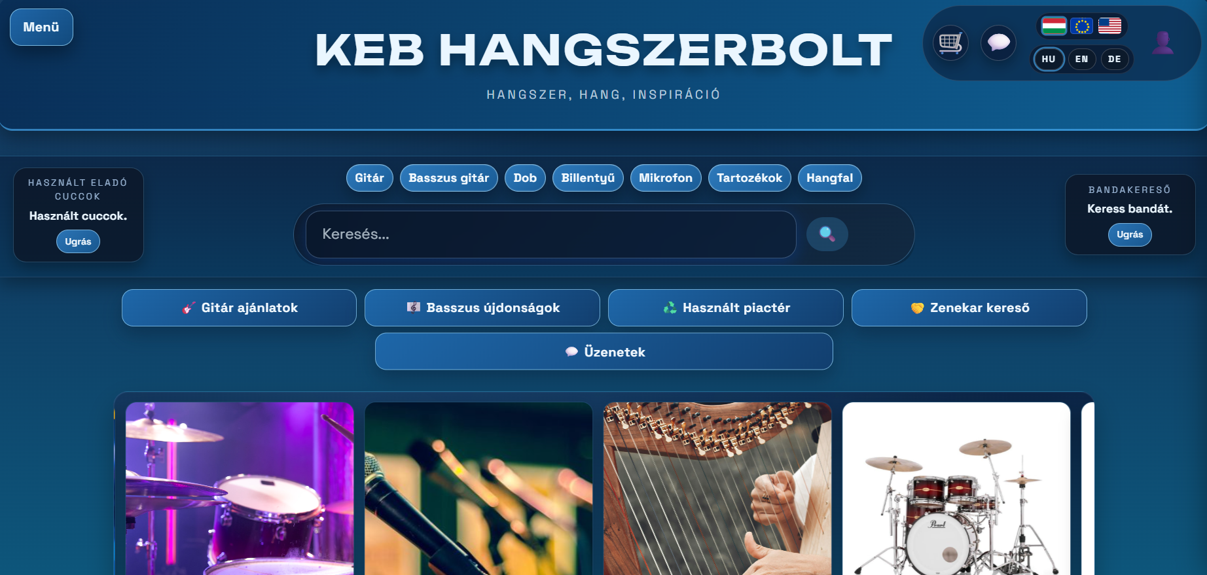
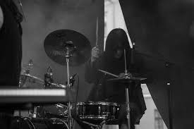

FRONTEND – Tóth Botond
Reason for our colors
Our Music teacher, always used the color blue for his projects, and we grew fond of it.
Our Favourite type of music is made with electrical instruments. And blue reminds us of electricity
This two fact made us choose the color blue.
there are ligther themes in the settings of our page for people who have hard time operating colored pages

Slide 7
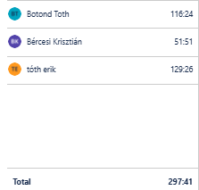
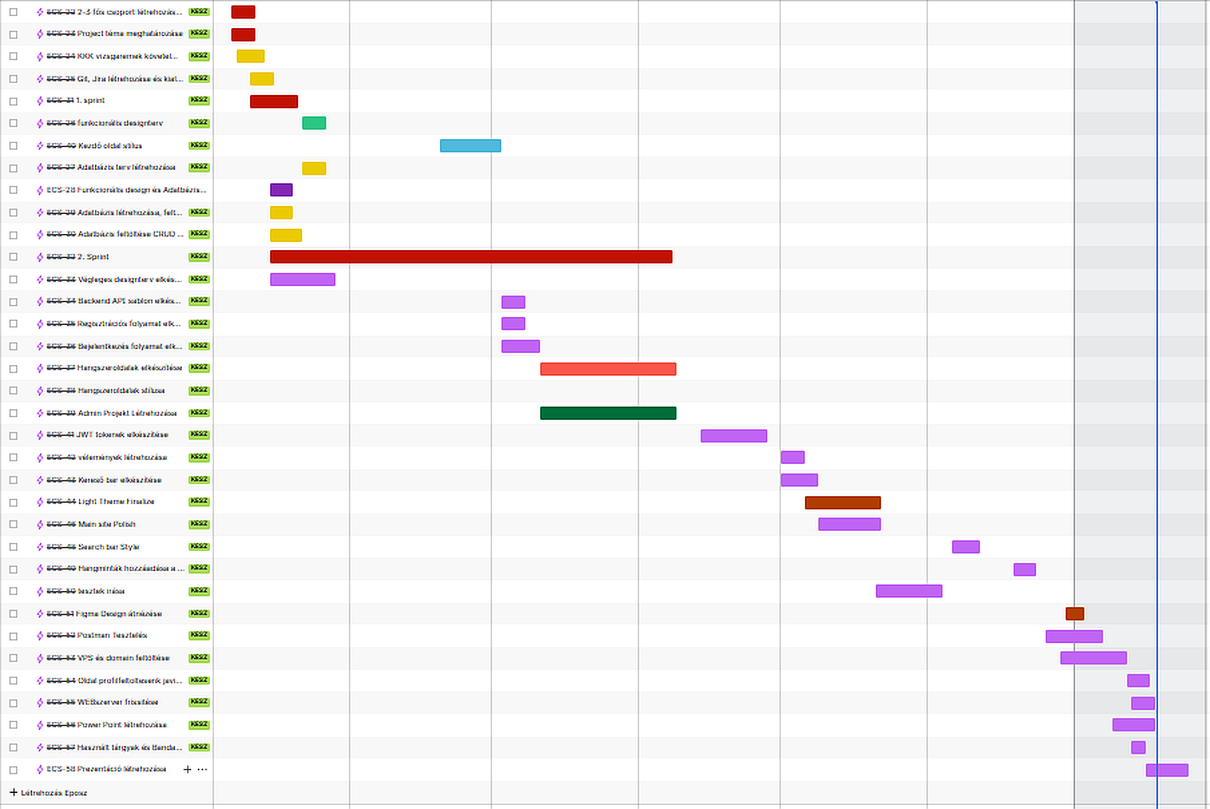
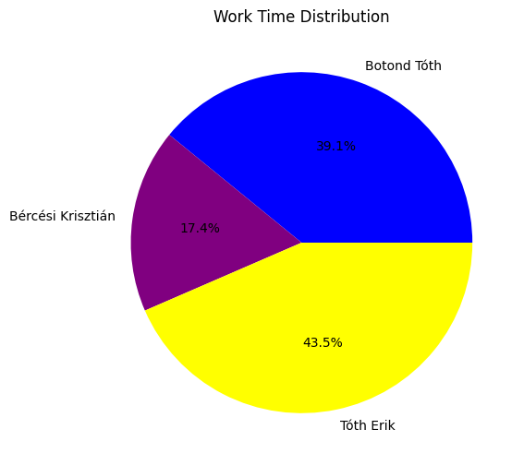
JIRA workspace
JIRA
We used JIRA to log our hours of working on the project
We used different colors for every type of mission we had for ourselves
We worked a total of 297 hours on the project
Tóth Botond 116 hours
Bércesi Krisztián 51hours
Tóth Erik 129 hours

Slide 8
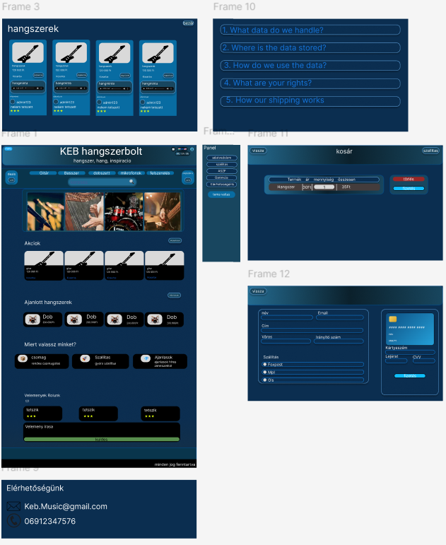
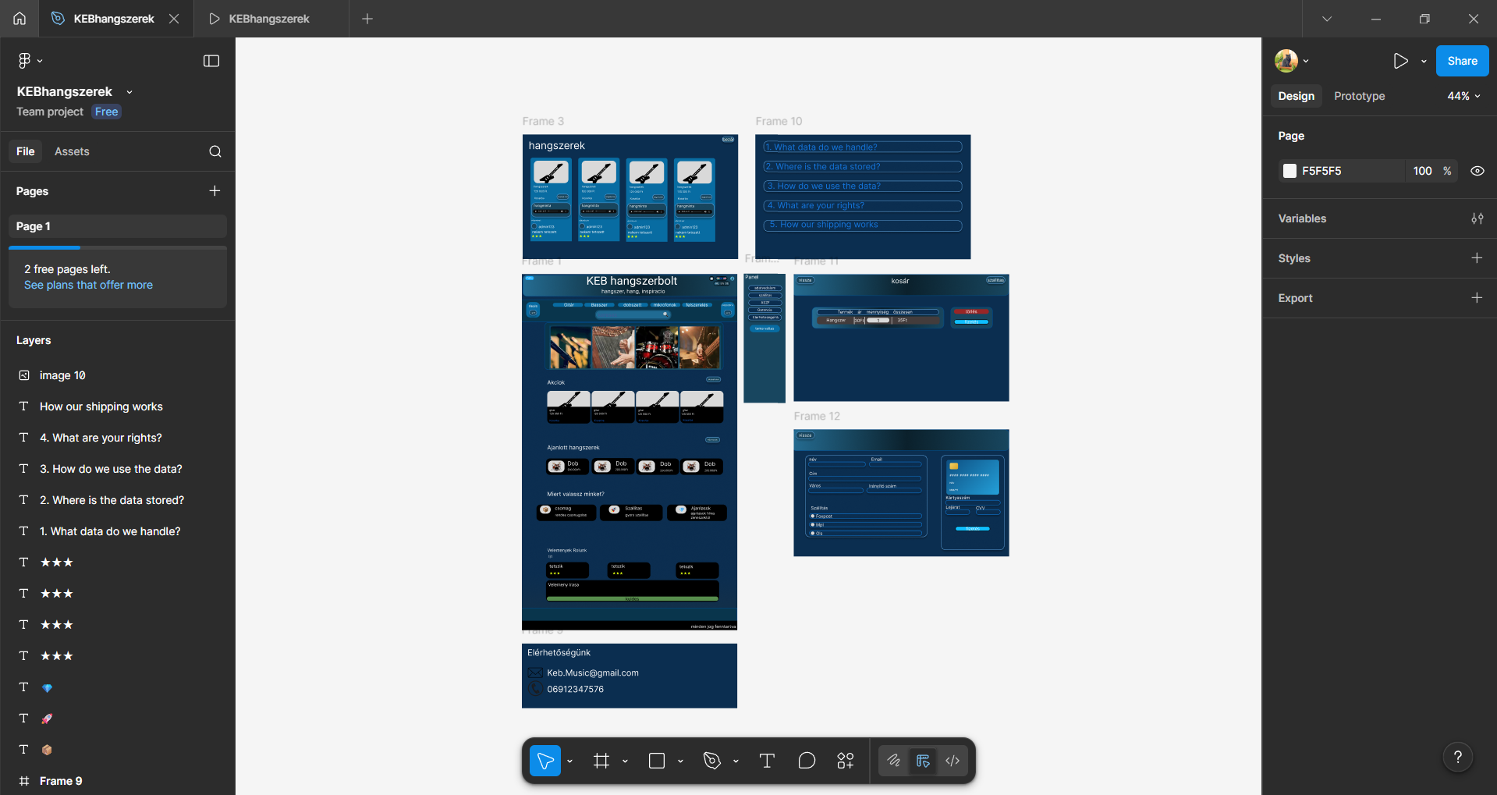
My Figma desing
Figma Desing
This was my first visualization of the pages desing, though this changed through development.

Slide 9

BACKEND – Bércesi Krisztián
01
02
03
04
My languages
The process of me creating the website
How i connected the backend to database
Our Communication

Slide 10
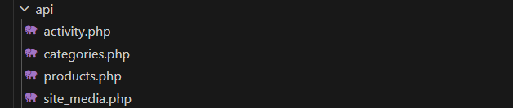

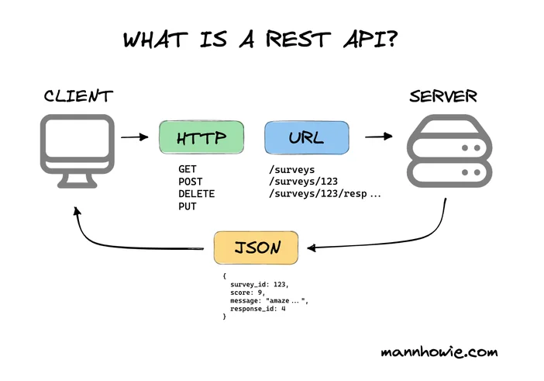
BACKEND – Bércesi Kriszitán
API’s
We used a REST API for communication.
It allowed independent operation of the two systems.
Data is transferred in JSON format.
It simplified database integration and real-time data display.
The REST architecture improved scalability and maintainability.

Slide 11


BACKEND – Bércesi Kriszitán
My languages
I mainly used PHP for the backend because it was convenient to work with, easy to test, and straightforward to connect to the database.
I also combined PHP with some JavaScript to create dynamic product pages.
This combination allowed me to create a responsive and efficient webshop environment
I also used HTML to give the page a base structure

Slide 12
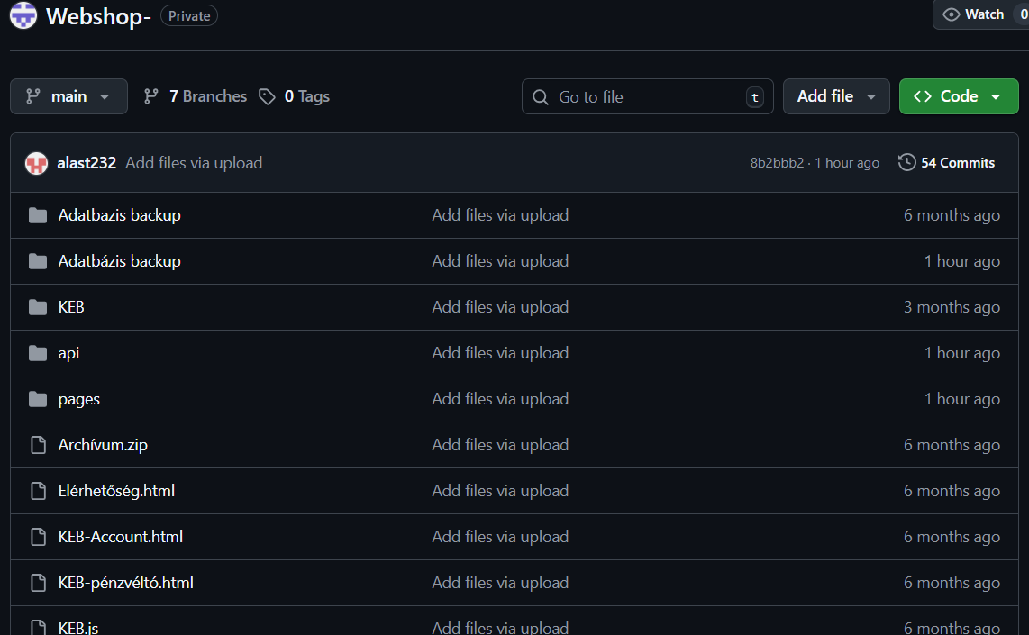
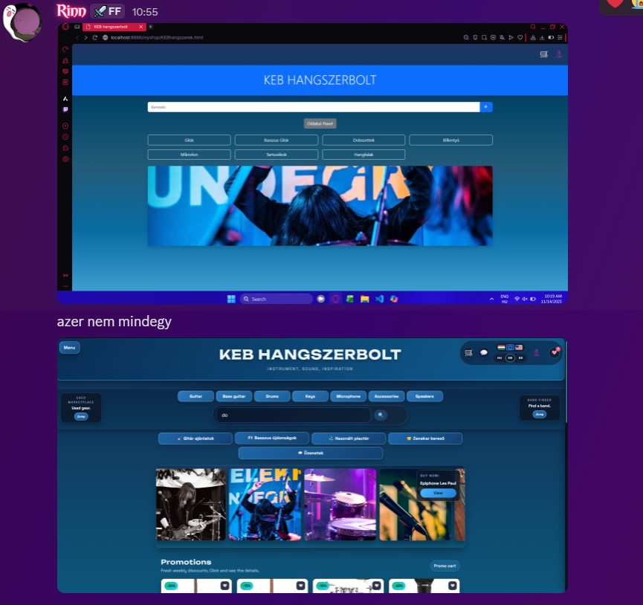
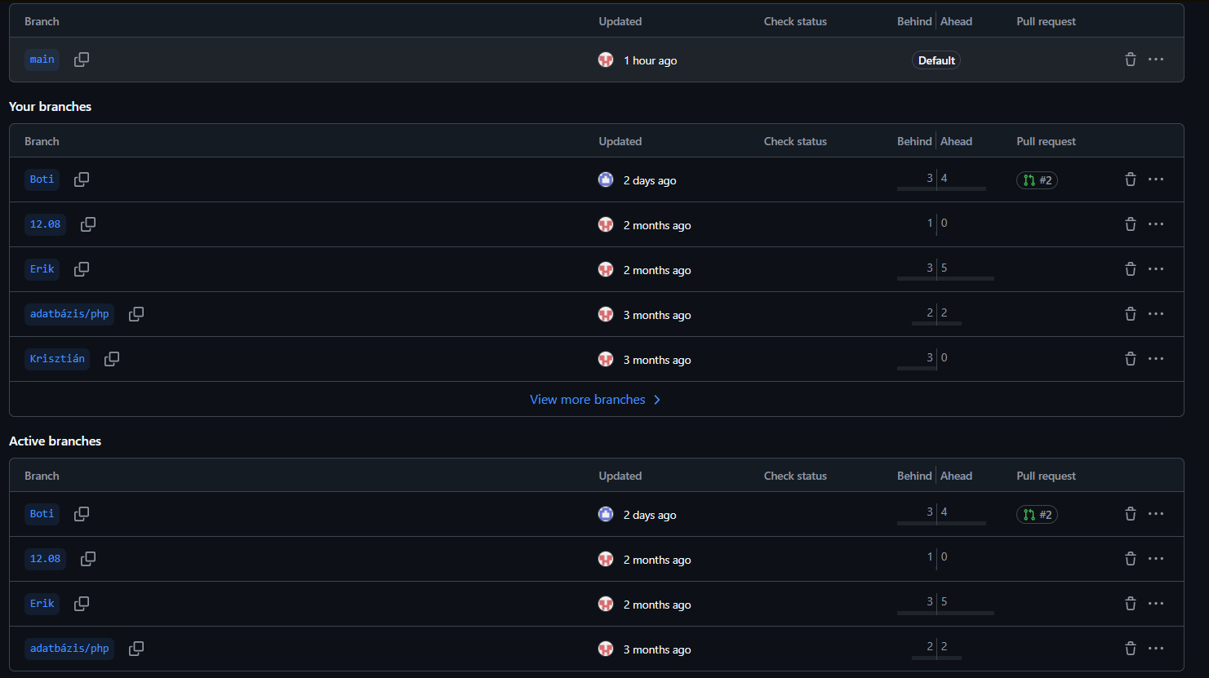
Our communication
Communication
We used Github to share our files with each other and made different branches for all of us
This made file sharing convenient
We also used discord for communication which really helped during home office days

Slide 13
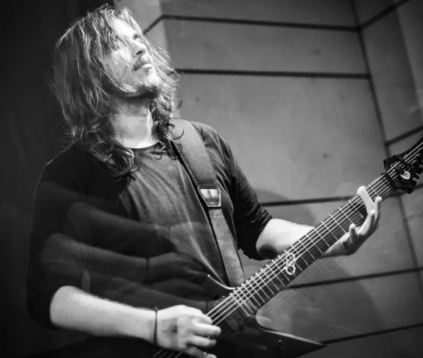
DATABASE – Tóth Erik
01
02
03
04
My Database setup
Database contents
My work with webservers and domains

Slide 14

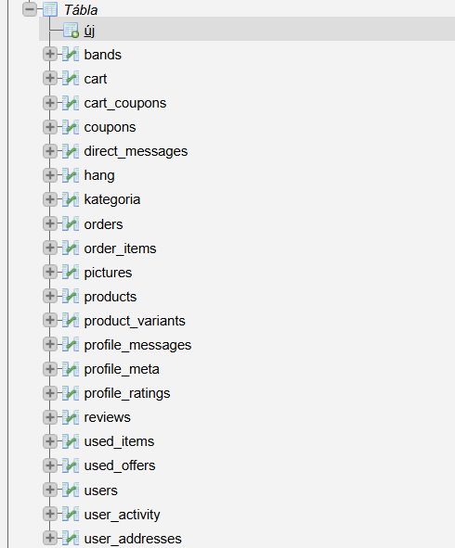
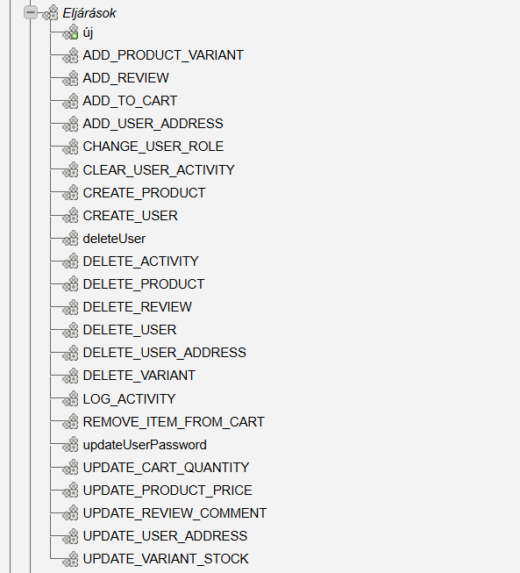
DATABASE – Tóth Erik
Database
I used SQL for managing the database.
It provided structured and reliable data storage.
Allowed efficient handling of products, users, orders, and reviews.
Supported CRUD operations through backend API endpoints.

Slide 15
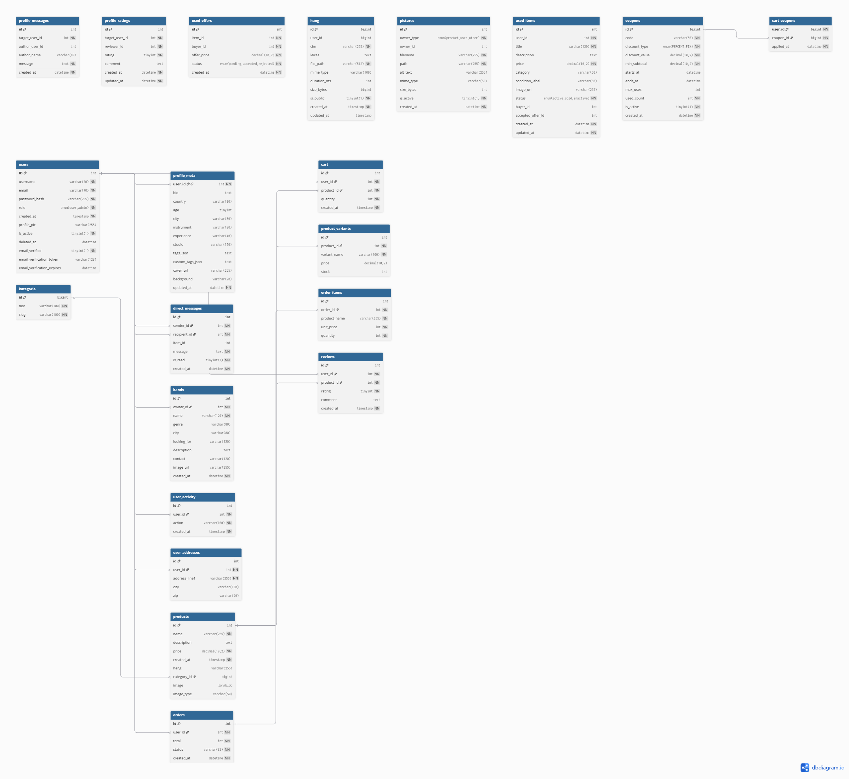


DATABASE – Tóth Erik
Database contents
Main use case: one platform for e-commerce, user profiles, chat, and used-item marketplace
Storage engine: Inno DB
encoding: utf8 / utf8mb4
The database includes 20+ stored procedures for CRUD and business operations

Slide 16

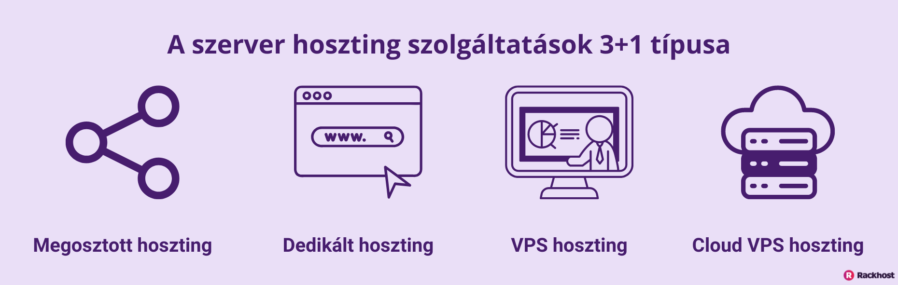

DATABASE – Tóth Erik
VPS/DOMAIN
We used Rackhost to publish and host our website.
I handled the VPS and domain setup, including server configuration.
Database and backend services were connected and tested on the live server.
The infrastructure setup was completed collaboratively with the team.

Slide 17
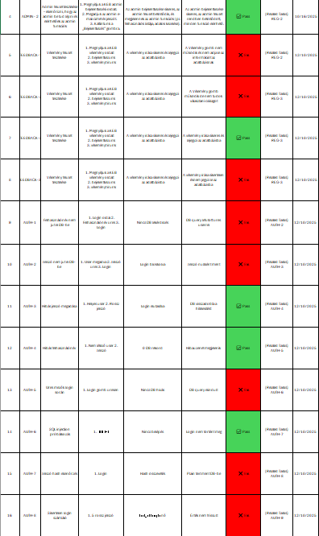

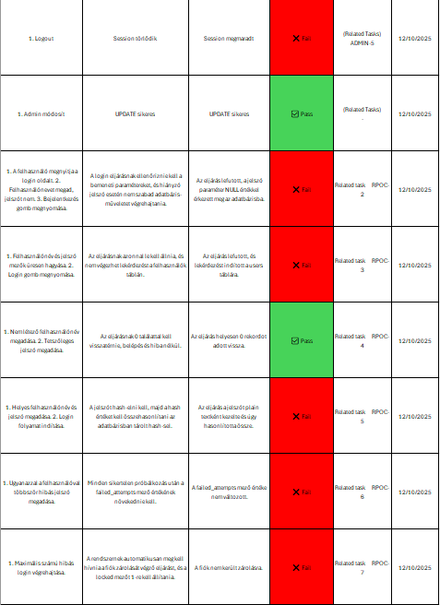
DATABASE – Tóth Erik
Our Tests
We developed our own Excel‑based tests to record data consistently and evaluate results quickly.
There were 3 slides for everyone of us
We each made 30-50 tests

Slide 18
Page Demo
DEMO
Add title text
Add title text

Slide 19
Questions
Q&A
Add title text
Add title text

Slide 20
THANK YOU FOR YOUR ATTENTION
Notes:
Add title text

